Slide 1




NEXT GEN EMPLOYABILITY PROGRAM
Creating a future-ready workforce
Team Members:
College Name
SRM TRP Engineering College
Student Name : BARATHRAJ S
Student ID : au814721104011

Slide 2

CAPSTONE PROJECT SHOWCASE
Project Title
Notes Sharing Web Application using Django Framework
Abstract | Problem Statement | Project Overview | Proposed Solution | Technology Used | Modelling & Results | Conclusion

Slide 3
Abstract
Our upcoming web platform aims to streamline document sharing between educators and students within an academic context. Built using the Django framework, it will provide an easy-to-use interface for uploading, downloading, and organizing files. Users can create accounts, join specific groups (such as classes or departments), and share files within those groups. We prioritize robust security measures to ensure that only authorized individuals have access. Ultimately, our goal is to enhance document collaboration and knowledge exchange within educational circles.”
Source :

Slide 4
Problem Statement
In traditional academic environments, the process of exchanging documents between students and instructors can be cumbersome and inefficient. Students often need to submit assignments or access learning materials, while instructors must distribute course materials and provide feedback. However, existing methods, such as email or physical submissions, lack organization and can lead to misplaced documents. To address these challenges, our initiative aims to develop a web-based platform that streamlines document sharing between students and instructors. This platform will serve as a centralized hub for uploading, downloading, and organizing files, promoting collaboration and productivity within educational circles
Source :

Slide 5
Project Overview
Our initiative involves creating a web application using the Django framework to enhance document exchange between students and educators. The platform will provide an intuitive interface for uploading, downloading, and managing files, specifically designed for educational contexts. Let’s delve into the key features:
User Authentication: Students and instructors can create accounts and sign in to the system.
File Upload and Download: Users can share documents by uploading them and retrieve files shared by others.
Group Creation and Administration: Users can establish groups (such as classes or departments) and distribute documents within these groups.
Access Control: Documents are accessible only to authorized users, ensuring confidentiality and security.
Notifications: Users receive alerts for new document uploads, comments, or other relevant activities.
Search Capability: Users can search for documents based on keywords, tags, or other criteria.
User Profile: Users can view and manage their profile details, including uploaded files.
Our ultimate goal is to foster collaboration and productivity within academic circles."
Source :

Slide 6
Proposed Solution
Our initiative involves developing a web-based application using the Django framework, which will serve as a centralized hub for students and instructors to exchange files. Let’s delve into the key elements:
User Administration: Both students and instructors can create accounts, sign in, and manage their profiles. Rigorous user verification ensures that only authorized individuals gain access.
File Organization: Users can upload files, categorize them into directories, and retrieve shared files. The application will seamlessly handle diverse file types, including documents, images, and videos.
Group Supervision: Users can establish or join groups (such as classes or departments) and distribute files within these groups. Group managers will oversee memberships and permissions.
Access Management: Files will be accessible solely to sanctioned group members, ensuring confidentiality and privacy. Administrators can configure permissions for viewing, uploading, or deleting files within a group.
Notifications: Users will receive alerts for new file uploads, comments, or relevant activities within their groups, enhancing engagement with the platform.
Search Feature: Users can search for files based on keywords, tags, or other criteria, streamlining the process of locating relevant materials.
Adaptive Layout: The application will feature an adaptive design, ensuring accessibility and usability across various devices, including computers, laptops, tablets, and smartphones.
In summary, our proposed solution aims to provide an intuitive and effective platform for students and instructors, fostering collaboration and communication within educational communities." ¹
.
.

Slide 7


Technology Used
Front-end
Back-end
Source :

Slide 8
Modelling & Results
Our developed web platform caters to both students and teachers. Upon visiting the landing page, users encounter login and signup options, serving as the entry point to the application. Rigorous validation processes, including those for “username” and “password,” ensure robust security.
Once logged in, students seamlessly navigate to a home page where they can view and download files shared by teachers. Conversely, teachers, upon login, gain the ability to upload files. In the event of a username or password mismatch, the webpage promptly indicates restricted access. Additionally, any errors trigger a 404 page, signaling “page not found.”
Our goal is to create a user-friendly environment that fosters efficient document exchange within the academic community.
Source :

Slide 9
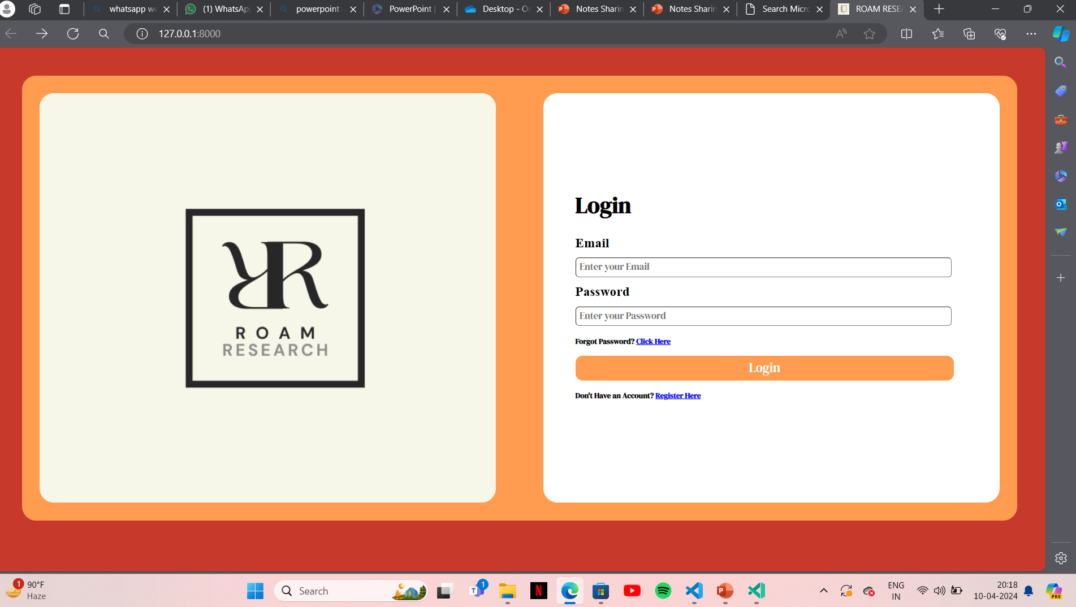
Login page

Slide 10
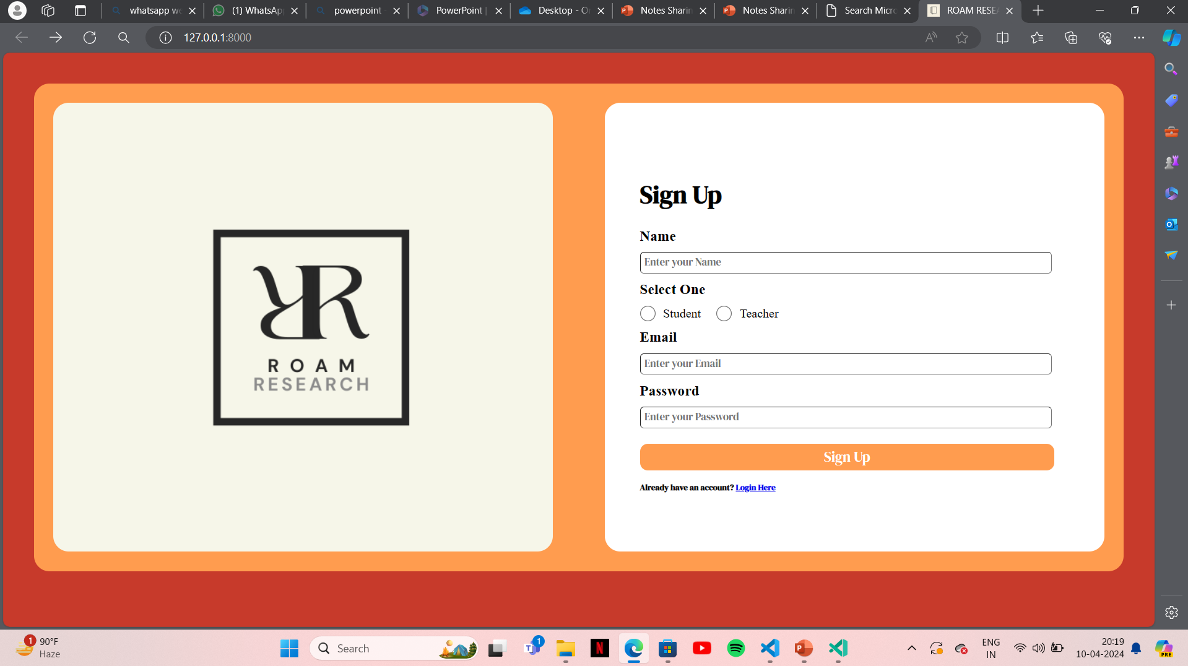
Sign up page

Slide 11
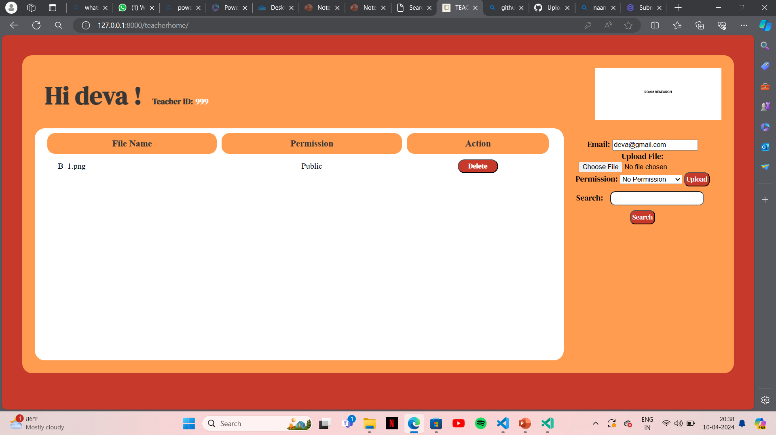
Teachers home page

Slide 12
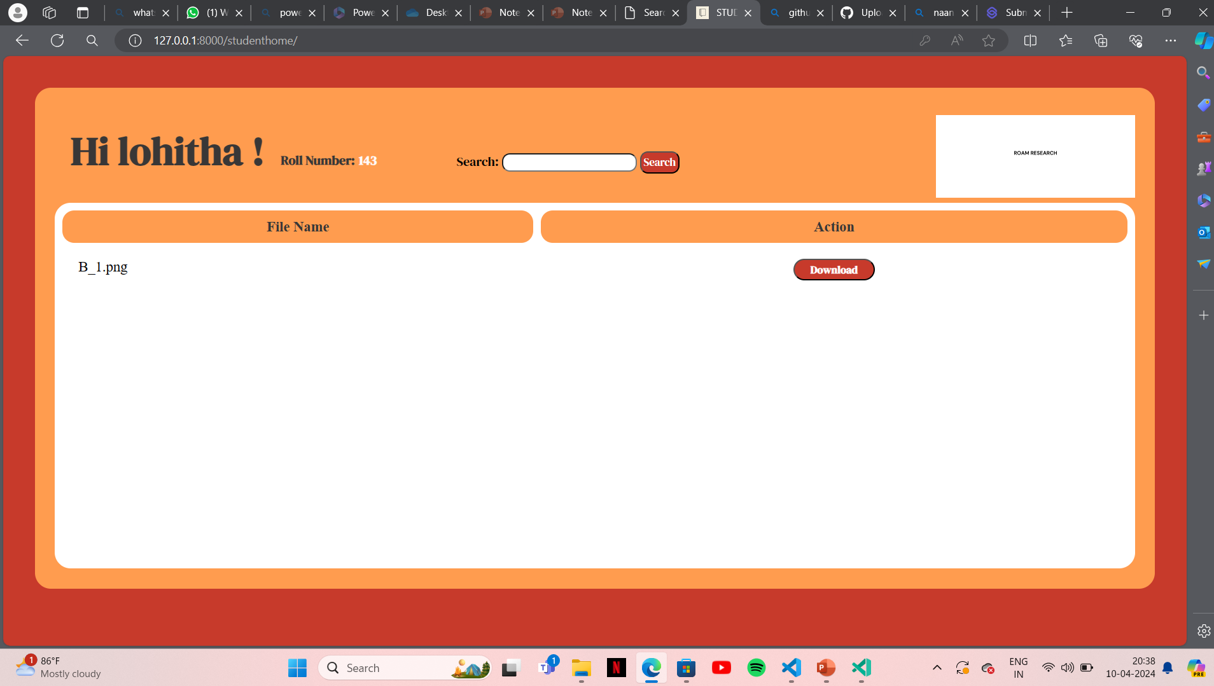
Students home page

Slide 13
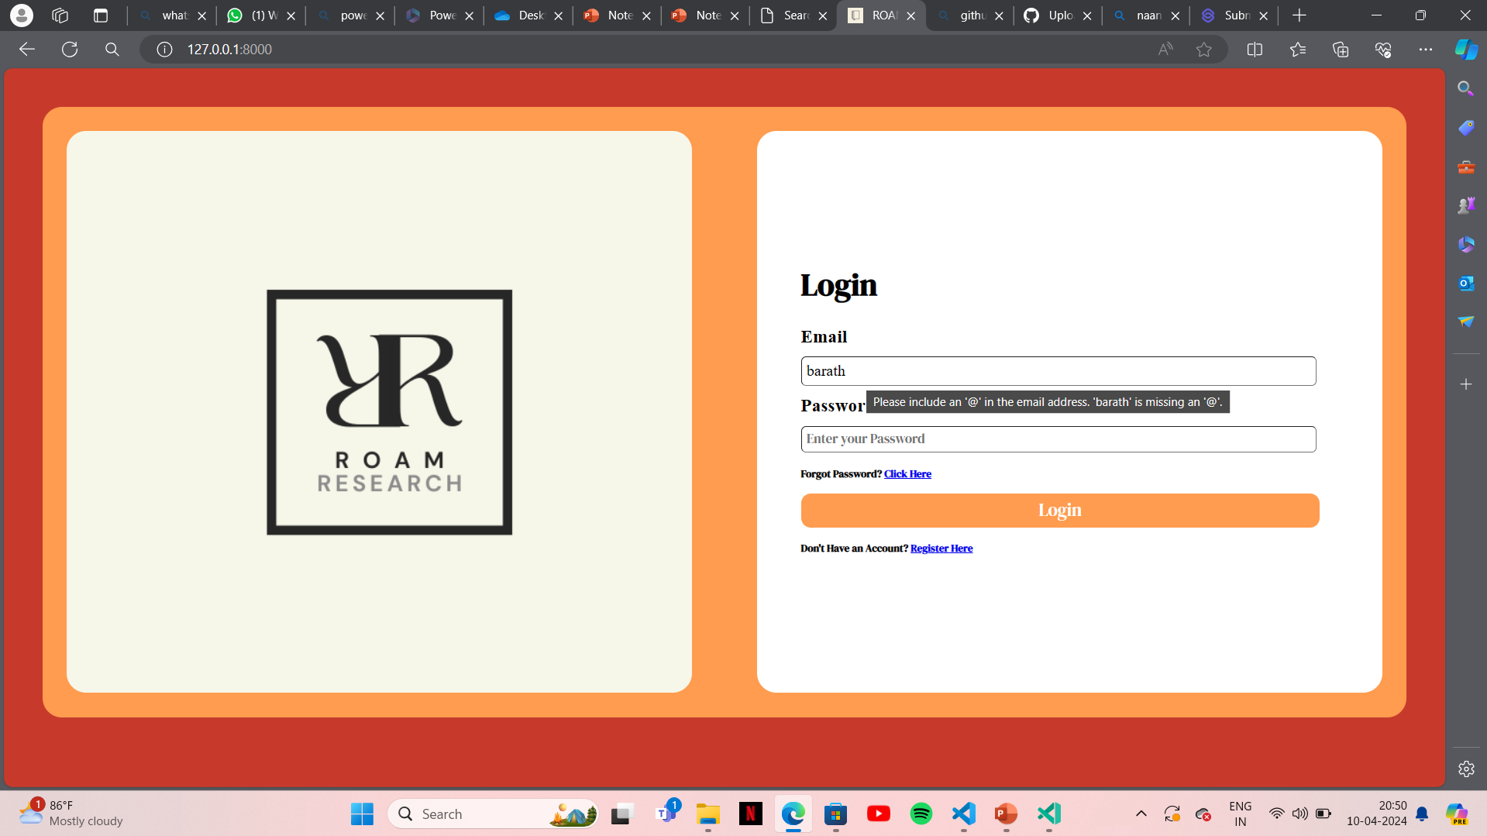
Error notification page

Slide 14
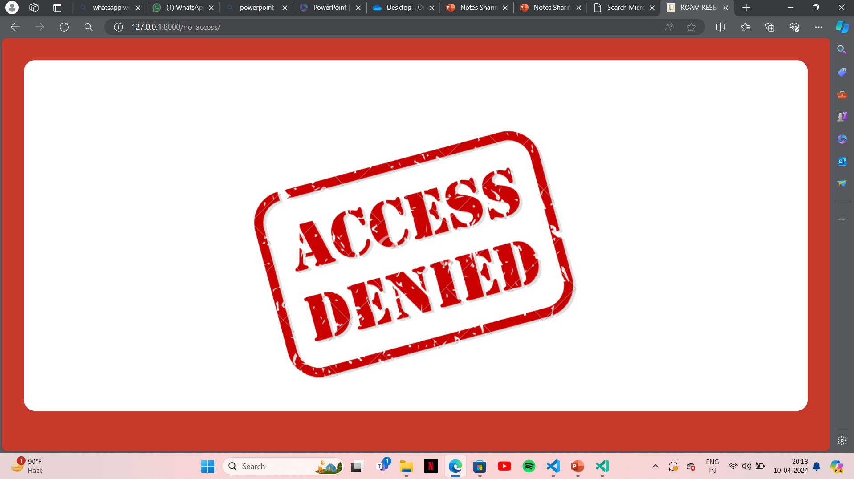
No access

Slide 15
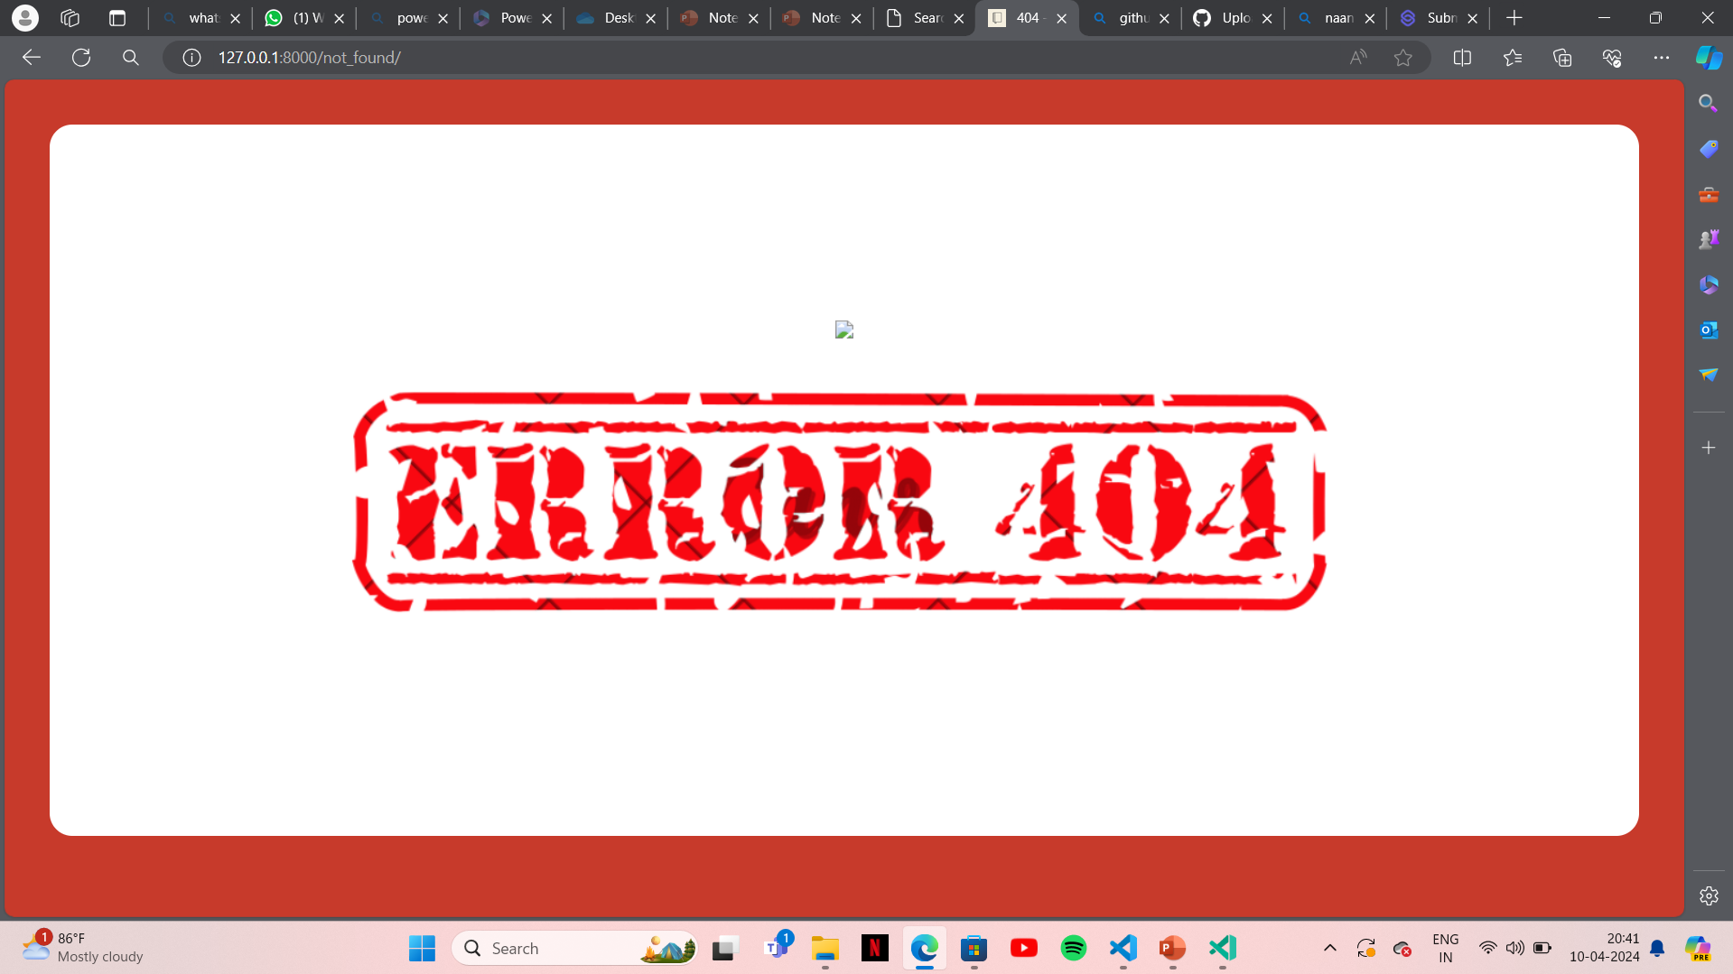
404 ERROR

Slide 16
Future Enhancements:
Our initiative involves integrating the application with Learning Management Systems (LMS), renowned platforms used in educational workflows. This integration will streamline file exchange within existing academic processes.
Let’s explore the key enhancements:
File Versioning: We’ll incorporate version control for files, allowing users to track changes and revert to previous versions when needed.
Cloud Storage Integration: Users can connect their cloud storage accounts (such as Google Drive or Dropbox) for seamless file access and sharing.
Real-time Collaboration: We’ll introduce features for live collaboration on documents, enabling simultaneous editing and commenting.
Advanced Search: Elevate the search capability by adding filters, sorting features, and the ability to search within file contents.
Analytics and Reporting: Our platform will offer analytics and reporting functionalities to monitor file usage, user interactions, and engagement metrics.
Integration with Online Learning Tools: By merging with online learning tools (such as quizzes or forums), we’ll provide a comprehensive educational platform.
These improvements will enrich the functionality and user-friendliness of our file-sharing application, making it an even more valuable resource for students and educators within educational settings.

Slide 17
Conclusion
Our initiative involves developing a web-based application using the Django framework, which will serve as a centralized hub for students and instructors to exchange files. Let’s delve into the key elements:
User Administration: Both students and instructors can create accounts, sign in, and manage their profiles. Rigorous user verification ensures that only authorized individuals gain access.
File Organization: Users can upload files, categorize them into directories, and retrieve shared files. The application will seamlessly handle diverse file types, including documents, images, and videos.
Group Supervision: Users can establish or join groups (such as classes or departments) and distribute files within these groups.
Access Management: Files will be accessible solely to sanctioned group members, ensuring confidentiality and privacy. Administrators can configure permissions for viewing, uploading, or deleting files within a group.
Notifications: Users will receive alerts for new file uploads, comments, or relevant activities within their groups, enhancing engagement with the platform.
Search Feature: Users can search for files based on keywords, tags, or other criteria, streamlining the process of locating relevant materials.
Future Enhancements: We envision real-time cooperation, advanced search options, and seamless integration with educational platforms to further elevate the tool’s usefulness and user involvement.
In essence, our proposed solution addresses the shortcomings of traditional file-sharing methods in educational settings, providing a resilient platform for secure and efficient file exchange among students and teachers."
Source :

Slide 18
Thank You!
Notes:
Thank You !!

